Slide 1

CAPSTONE PROJECT-2 Seoul Bike Sharing Demand Prediction
TEAM MEMBERS
AMITHA K
APOORVA VISHWAKARMA
ABHISHEK P SADAWARTE
MOHD KHALID
SHASHANK KUMAR YADAV

Slide 2

CONTENT
INTRODUCTION
PROBLEM STATEMENT
DATA SUMMARY
EXPLORATORY DATA ANALYSIS
CHALLENGES FACED
CONCLUSION
Q AND A

Slide 3

INTRODUCTION
A Bicycle-sharing system, Bike share program, Public bicycle scheme or Public bike share (PBS) scheme, is a shared transport service where bicycles are available for shared use by individuals for a short-term at low or zero cost.
The programs themselves include both docking and dock less systems, where docking systems allow users to borrow a bike from a dock, i.e., a technology-enabled bicycle rack and return at another node or dock within the system and dock less systems, which offer a node-free system relying on smart technology. In either format, systems may incorporate smartphone web mapping to locate available bikes and docks.

Slide 4

PROBLEM STATEMENT
Currently Rental bikes are introduced in many urban cities for the enhancement of mobility comfort. It is important to make the rental bike available and accessible to the public at the right time as it lessens the waiting time. Eventually, providing the city with a stable supply of rental bikes becomes a major concern. The crucial part is the prediction of bike count required at each hour for the stable supply of rental bikes.

Slide 5
DATA SUDMMARY
The dataset contains weather information (Temperature, Humidity, Windspeed, Visibility, Dewpoint, Solar radiation, Snowfall, Rainfall ) the number of bikes rented per hour and date information.
The columns of the dataset are as follows:
Date : year-month-day
Rented Bike count - Count of bikes rented at each hour
Hour - Hour of he day
Temperature-Temperature in Celsius
Humidity - %

Slide 6
DATA SUMMARY
Windspeed - m/s
Visibility - 10m
Dew point temperature - Celsius
Solar radiation - MJ/m2
Rainfall - mm
Snowfall - cm
Seasons - Winter, Spring, Summer, Autumn
Holiday - Holiday/No holiday
Functional Day - NoFunc(Non Functional Hours), Fun(Functional hours)

Slide 7

Exploratory Data Analysis
Exploratory Data Analysis refers to the critical process of performing initial investigations on data so as to discover patterns, to spot anomalies, to test hypothesis and to check assumptions with the help of summary statistics and graphical representations.

Slide 8
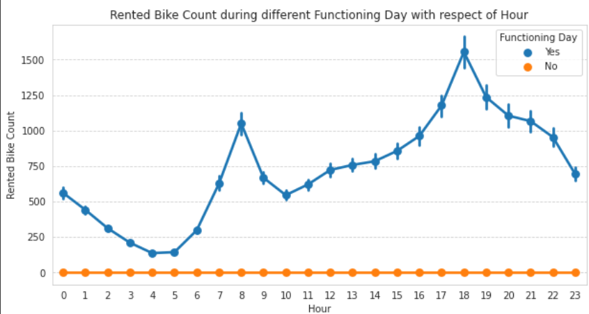
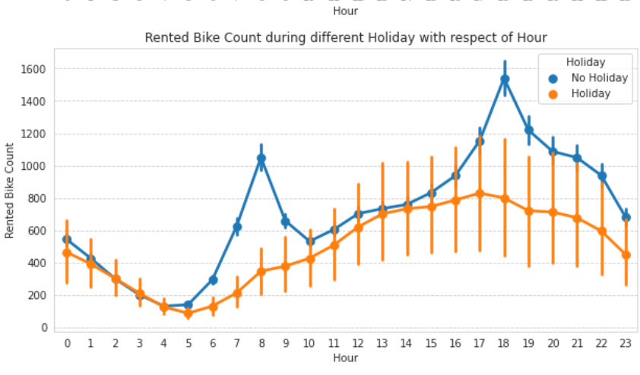
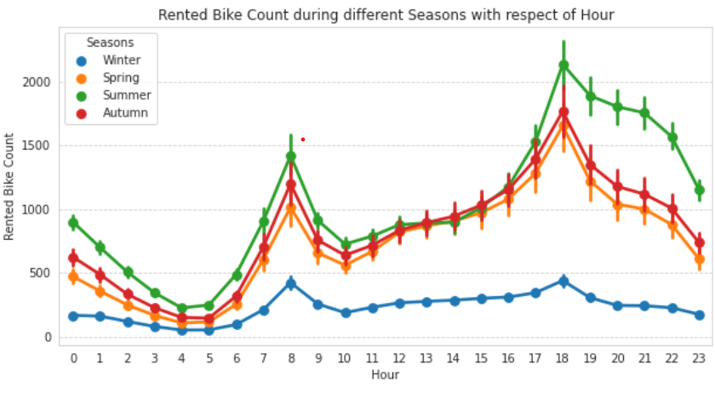
Rented bike count ,hour with respect to different categorical features

Slide 9
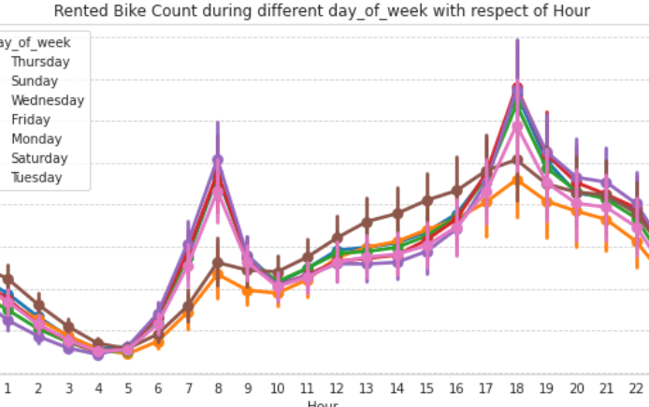
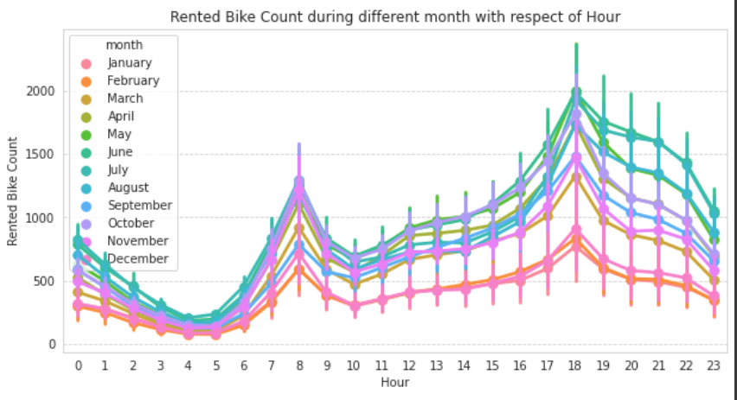
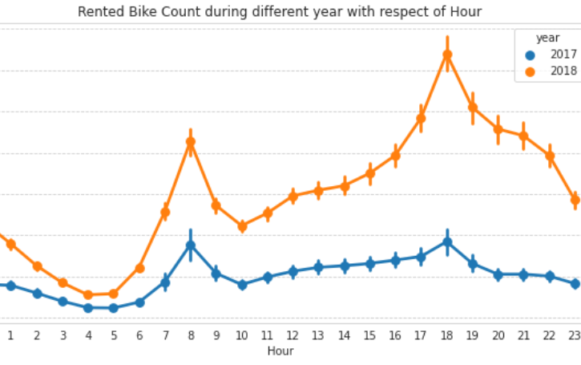
Rented bike count vs hour

Slide 10
Observations
From all these point plot we have observed a lot from every column .
Season
In the season column, we are able to understand that the demand is low in the winter season.
Holiday
In the Holiday column, The demand is low during holidays, but in no holidays the demand is high, it may be because people use bikes to go to their work.
Functioning Day
In the Functioning Day column, If there is no Functioning Day then there is no demand

Slide 11
Observations
Days of week
In the Days of week column, We can observe from this column that the pattern of weekdays and weekends is different, in the weekend the demand becomes high in the afternoon. While the demand for office timings is high during weekdays, we can further change this column to weekdays and weekends.
Month
In the month column, We can clearly see that the demand is low in December January & February, It is cold in these months and we have already seen in season column that demand is less in winters.
Year
The demand was less in 2017 and higher in 2018, it may be because it was new in 2017 and people did not know much about it.

Slide 12
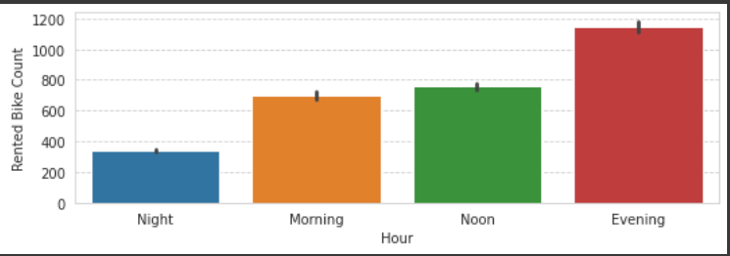
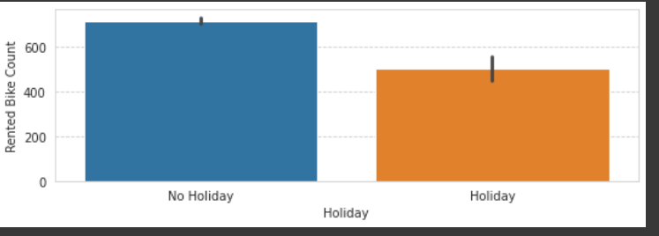
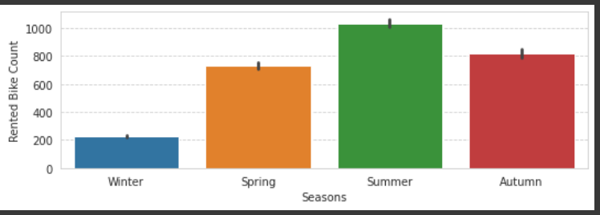
Visualization of value counts

Slide 13
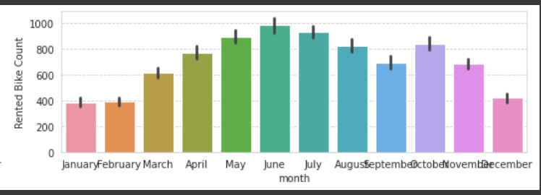
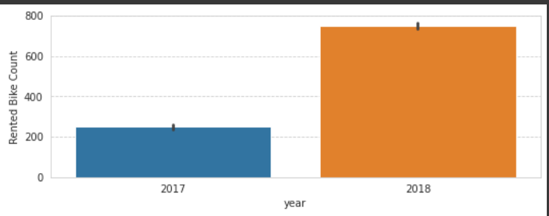
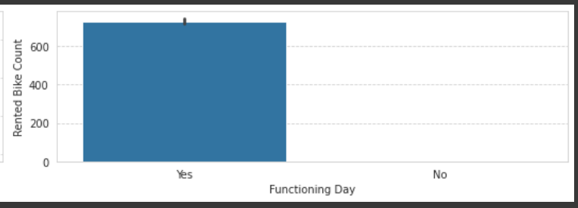
Visualization of value counts

Slide 14
Key findings
We can see that there is less demand in winter season and high demand in summer season and other seasons.
There is high demand during evening time and low demand at night.
There is low demand during holidays .
Also there is high demand during functional days compared to nonfunctional days .
We can see that there is less demand if rented bike in the month of December , January , February i.e. winter months and high demand during summer seasons.

Slide 15
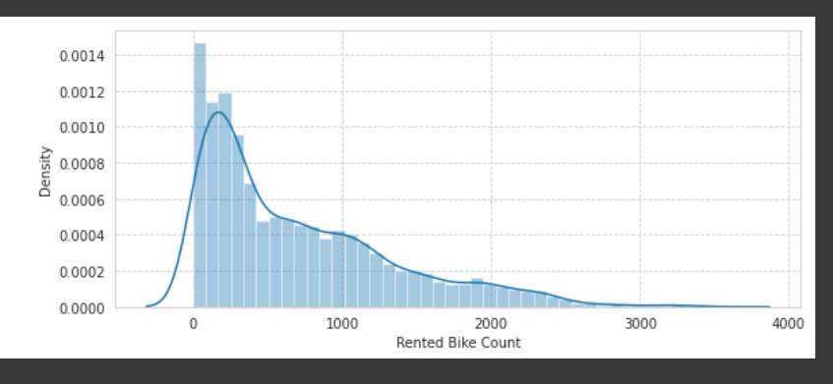
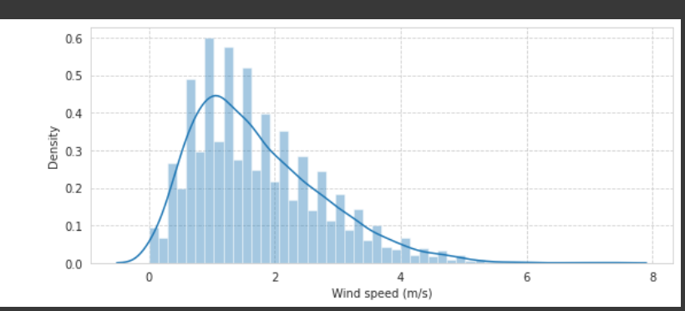
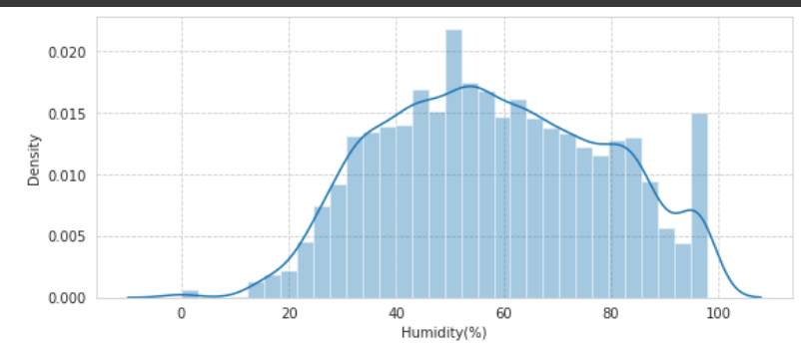
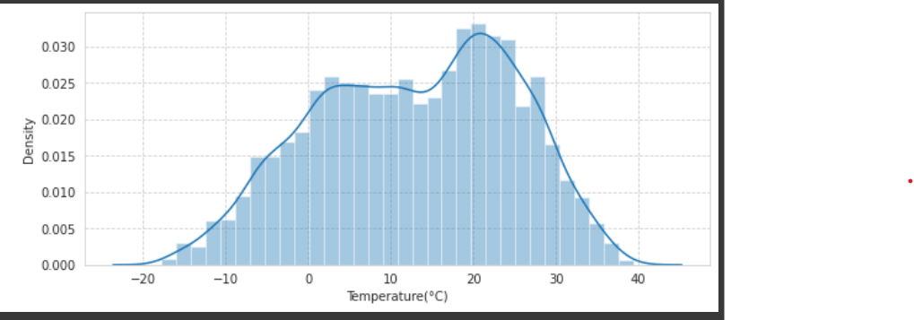
Distribution of numerical features
A histogram is a chart that plots the distribution of a numeric variable’s values as a series of bars. Each bar typically covers a range of numeric values called a bin or class; a bar’s height indicates the frequency of data points with a value within the corresponding bin.

Slide 16
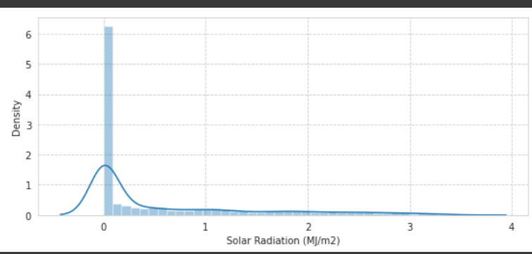
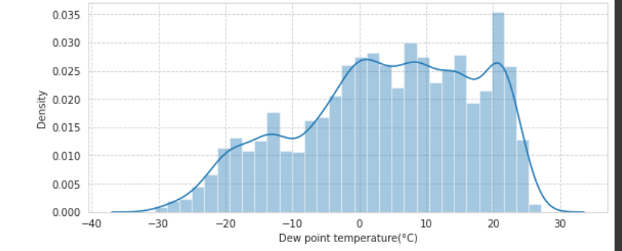
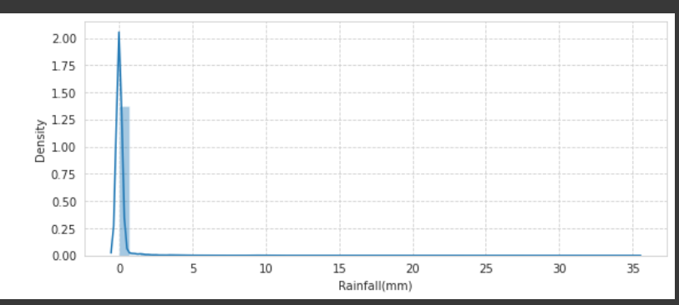
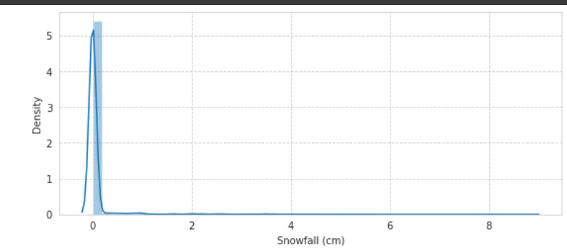
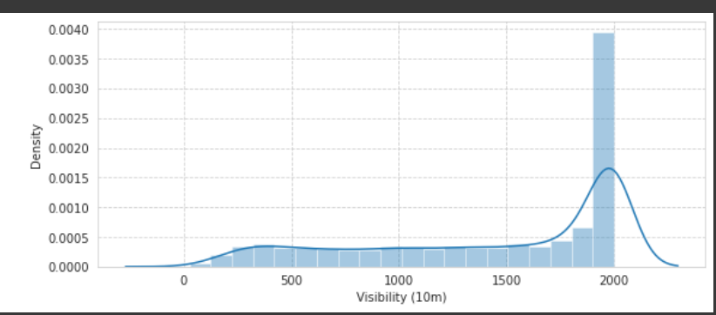
Distribution of numerical feature

Slide 17
Key Observation
In Distplot plots we observe that some of our columns is right skewed and some are left skewed we have to remember this things when we apply algorithms
Right skewed columns are - Rented Bike Count (Its also our Dependent variable), Wind speed (m/s), Solar Radiation (MJ/m2), Rainfall(mm), Snowfall (cm).
Left skewed columns are - Visibility (10m), Dew point temperature(°C)
From Histogram we are coming to know that the features which are skewed, their mean and the median are also skewed, which was understood by looking at the graph that this would happen.

Slide 18
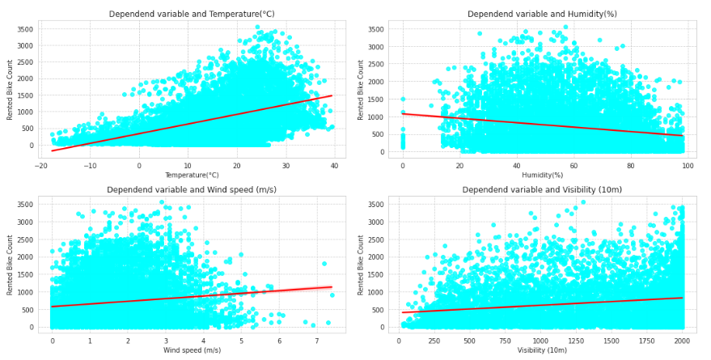
Regression plot Lets try to find how is the relation of numerical features with our dependent variable

Slide 19
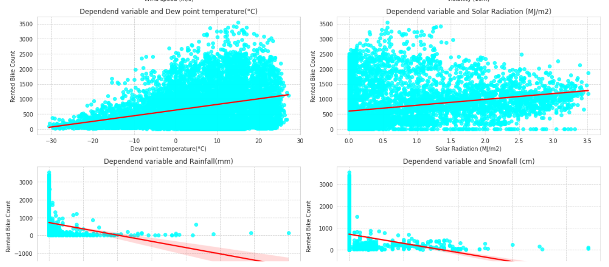
These regression plots shows that some of our features are positive linear and some are negative linear in relation to our target variable Now is the time to know what is the correlation of our dependent variable with the independent features

Slide 20
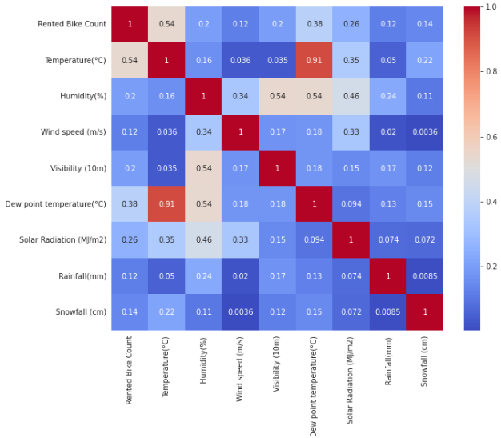
Correlation Analysis
From the correlation graph with
Heat map we saw that dew point
temp and temperature is highly
correlated. Then we checked VIF and
concluded that these two features are
affecting VIF score also so we
decided to drop one of these feature
and to do this we checked which
feature is least correlated with
Dependent variable and we identified
it to be Dew point temperature and
therefore we dropped the Dew point temperature.

Slide 21
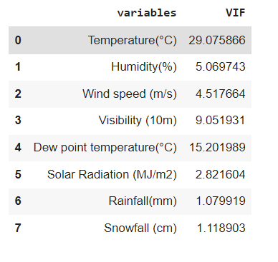
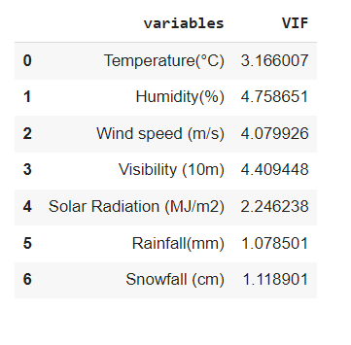
Multicollinearity check with the help of VIF
VIF score Before deleting ‘Dew Point Temperature’ column
VIF score after deleting ‘Dew Point Temperature’ column

Slide 22
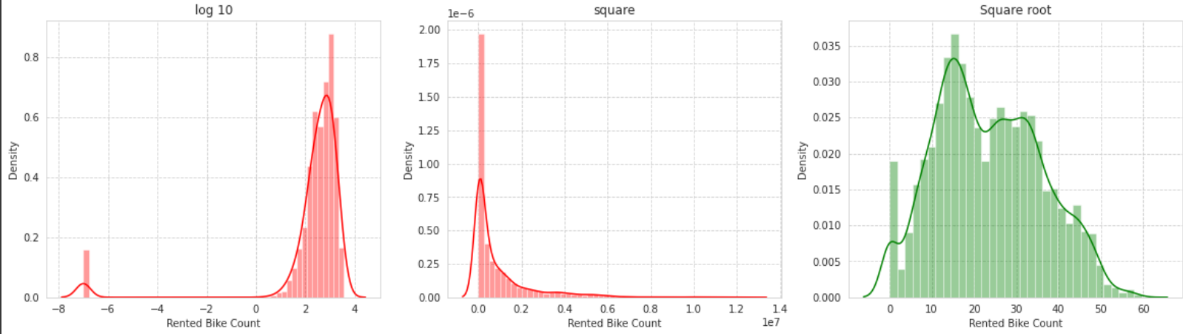
Normalize the dependent variable Our data in green plot is normalized to some extent: so we will go with square root on our dependent variable

Slide 23
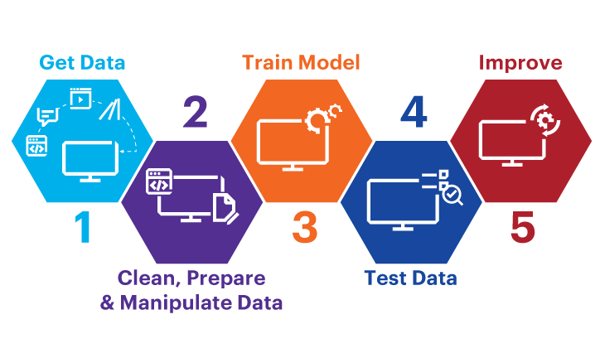
Machine Learning Model
Machine Learning models can be understood as a program that has been trained to find patterns within new data and make predictions. These models are represented as a mathematical function that takes requests in the form of input data, makes predictions on input data, and then provides an output in response.

Slide 24
List Of Models
Linear Regression with regularizations (Lasso Ridge)
Polynomial Regression
Decision tree
Random Forest
Gradient Boosting Regressor
Extreme Gradient Boosting
Ada boost

Slide 25
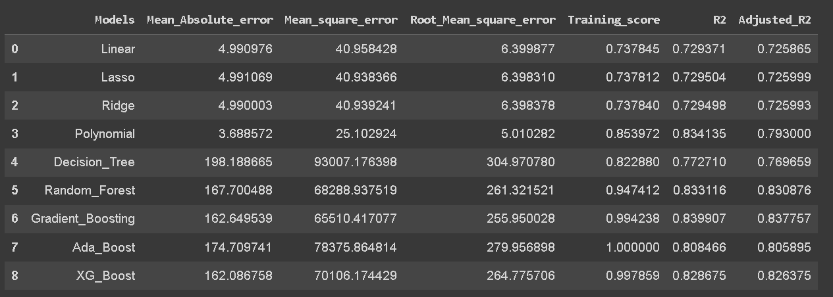
Creating Data Frame of all Evaluation Matrix with respect to models

Slide 26
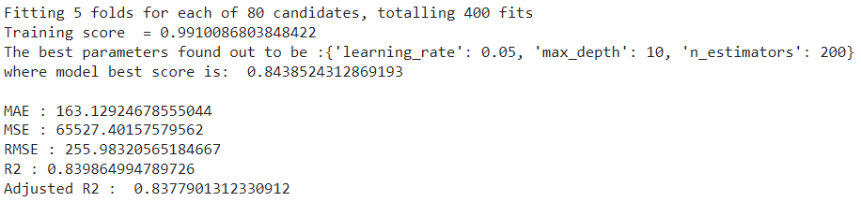
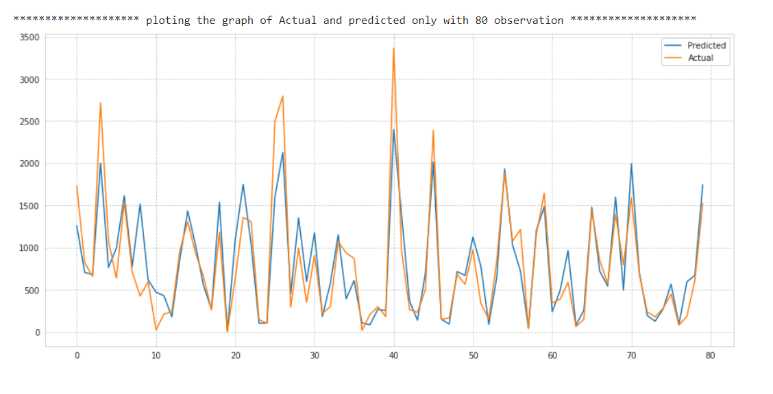
Gradient Boosting Regressor

Slide 27

Model Validation Selection
Observation 1 - As seen in the Model Evaluation Matrices table, Linear Regression is not giving great result.
Observation 2 - Random forest , ADA-boost and XG- boost have performed equally good in terms of adjusted R squared.
Observation 3 - We are getting the best results from Random forest and Gradient_Boosting

Slide 28
Challenges Faced
Reading the dataset and understanding of columns.
For understanding some questions we had to understand the business model of bike sharing , that how they work .
Handling of Nan values , null values and duplicated,
Converting date column type from object to date and then split it into three column i.e. Week , month and day column .
When we observe the data we realize that Hour column is a numerical column but it is a time stamp so we have to treat Hour as a categorical feature.

Slide 29
Challenges Faced
we observe that some of our columns is right skewed and some are left skewed so we treated them with log , square and square root.
regression plots shows that some of our features are positive linear and some are negative linear in relation to our target variable
From heatmap we are able to see that there is multicollinearity in temperature(°C) and dev point temperature(°C) column so we had to drop dew point temperature because temperature column was important.
Designing multiple visualizations to summarize the information in the dataset and successfully communicate the results and trend to the reader.

Slide 30
Conclusions
In holidays or non-working days there is demand in rented bikes.
There is a surge of high demand in the morning 8AM and in evening 6PM as the people might be going to their office at morning 8AM and returning from their office at the 6PM.
People preferred more rented bikes in the morning compared with evening.
When the rainfall was less, people have booked more bikes except some few cases.
The temperature, Hour are the most important features that positively drive the total rented bikes count.

Slide 31
Conclusions
It is observed that highest number of rental bikes counts in Autumn and summer seasons and the lowest in winter season.
We observed that the highest number of rental bikes counts on a clear day or little windy day and the lowest on a snowy and rainy day.
In the given dataset there was no strong relationship present between dependent variable "Rented bike count" and independent variables.
Out of all models we apply Decision tree and Random Forest model are most accurate and the reason is there are no specific relation between features.

Slide 32
Conclusions
Random Forest worked best in predicting the count of rented bikes as its R2 score is maximum from the tried model.
We are getting best results using Gradient Boost Regressor.
When we compare the RMSE and Adjusted R2 of all the models, Gradient-Boosting gives the highest score where R2 score is 0.8399 and Training score is 0.99 so this model is the best for predicting the bike rental count on daily basis.

Slide 33
THANK YOU

